Slide 1
PSCS211: HOSPITAL FINDER
PIP2001 Capstone Project
Review-0
Batch Number: CSE-G74
Under the Supervision of,
Dr. Prasad P S
Assistant Professor ( Senior scale )
School of Computer Science and Engineering
Presidency University
Roll Number | Student Name
20211CSE0497 | Yashas R Gowda
20211CSE0847 | Disha S
20211CSE0843 | Shashank K
Name of the Program: CSE
Name of the HoD: Dr. Asif Mohammed H.B
Name of the Program Project Coordinator: Mr. Amarnath J.L & Dr. Jayanthi. K.
Name of the School Project Coordinators: Dr. Abdul Khadar A

Slide 2
Content
Problem Statement
Github Link
Analysis of Problem Statement
Timeline of the Project
References

Slide 3
Problem Statement Number:PSCS211
Organization: CDK Global(India)Pvt Ltd
Category (Hardware / Software / Both) : Software
Problem Description: In the state of mind that a common person is in during a medical emergency, it becomes difficult to take calculated decisions such as which hospital to rush to. This lapse of decision could mean the difference between life or death for a loved one. Additionally, there are several aspects to consider such as availability of the required medical facilities, medicines, blood group and specialists to provide the patient with a maximum chance of survival in those crucial moments. Our app aims to be the solution, giving the user all the necessary information during a medical emergency taking into account their location and requirements and providing the best-suited hospital in that hour of need.
Difficulty Level: Simple
In Summary : → in Points… next slide

Slide 4
Problem Statement Number:
Problem Description-
Context: Difficulty in making quick, informed decisions during medical emergencies.
Key Issues:
- Common individuals may struggle to choose the right hospital under stress.
- Poor decision-making can impact survival chances for patients.
- Factors to consider include:
- Availability of medical facilities
- Required medicines
- Compatible blood groups
- Availability of specialists

Slide 5
Github Link
https://github.com/Yashas-PU/Hospitalfinder-Capstone2024
It’s a public repository and everything is accessible for everyone and there is a through road map how we are going to take this project further in a readme file in Github

Slide 6
Analysis of Problem Statement
Technology Stack Components:
1. Platform: Progressive Web App (PWA)
- Advantages: Cross-platform compatibility, responsive design, no need for separate app stores.
2. Geolocation:
- API: Geolocation API
- Purpose: Retrieve user’s current location for accurate hospital recommendations.
3. Mapping and Routing:
- Maps: OpenStreetMap
- Routing: Use Leaflet Directions API or similar services to find the shortest path to the nearest hospital.

Slide 7
Analysis of Problem Statement
4. Backend Services:
- Database: Firebase Realtime Database or Firestore
- Authentication: Firebase Hosting Firebase Authentication (for secure user access)
- Hosting: (for deploying the PWA)
5. Push Notifications:
- Service: Firebase Cloud Messaging (FCM)
- Purpose: Send real-time alerts and updates to users.
6. Additional Libraries:
- Service Worker: Implement for offline capabilities and performance improvements.
- Responsive Framework: Use a CSS framework like Bootstrap or Tailwind CSS to ensure the app is responsive and user-friendly.

Slide 8
Analysis of Problem Statement (contd...)
Software Requirements:
a .Development Tools:
IDE/Editor: Visual Studio Code, WebStorm, or Sublime Text.
Version Control: Git, with platforms like GitHub or GitLab.
b. Frameworks & Libraries:
Frontend: - HTML/CSS/JavaScript: Core technologies for building the PWA. ( Framework: React (for building the UI components)), CSS Framework: Bootstrap (for responsive design).
c. Mapping & Routing:
Maps: OpenStreepMap.
Routing: leaflet Directions API or equivalent.
d. Service Worker: For offline support and caching.
Push Notifications: Firebase Cloud Messaging (FCM).
e. Backend Services:
Database: Firebase Realtime Database or Firestore.
Authentication: Firebase Authentication.
Hosting: Firebase Hosting or any other cloud-based hosting service.

Slide 9
Analysis of Problem Statement (contd...)
f. APIs:
Geolocation: Geolocation API for retrieving user location.
Maps & Directions: leaflet or OpenStreatMap API.
g. Testing Tools:
Browser Testing: Chrome DevTools, Firefox Developer Tools.
Cross-Browser Testing: Tools like BrowserStack or Sauce Labs.

Slide 10
Analysis of Problem Statement (contd...)
2. Hardware Requirements:
a. Development Machine:
Processor: Modern multi-core processor (Intel i5/Ryzen 5 or better).
RAM: 8 GB or more.
Storage: SSD with at least 256 GB of available space.
Internet Connection: Stable and high-speed internet for development, testing, and deployment.
b. Server/Hosting:
Cloud Services: A cloud hosting provider like Firebase or AWS. (No specific hardware required as it’s managed by the provider.)
Backup: Ensure regular backups are configured.
c. Testing Devices:
Mobile Devices: A range of smartphones and tablets for testing responsiveness and functionality.
PCs/Macs: Various desktop configurations to test the PWA’s cross-platform compatibility.

Slide 11
Analysis of Problem Statement (contd...)
d. Analysis of Problem Statement (Short Points)
- Time Constraints: Urgent decisions are needed under stress.
- Lack of Information: Immediate access to hospital data is often missing.
- Complex Decision Factors: Need for information on facilities, specialists, and blood types.
- Geographical Issues: Finding the nearest and most suitable hospital quickly is crucial.
- Information Overload: Need for organized and accessible hospital information.
e. Proposed PWA Solution
- Real-Time Location: Uses GPS to pinpoint user location.
- Hospital Data: Aggregates information on facilities, specialists, and blood types.
- Routing & Navigation: Provides shortest path and real-time directions.
- Responsive Design: Accessible on various devices (PCs, tablets, smartphones).
- Push Notifications: Sends real-time alerts and updates.

Slide 12
Analysis of Problem Statement (contd...)
f. Benefits
- Timely Information: Reduces decision-making time.
- Improved Choices: Detailed data helps make informed decisions.
- Cross-Platform Accessibility: Available on multiple devices.
- Efficient Routing: Minimizes travel time and improves emergency response.

Slide 13
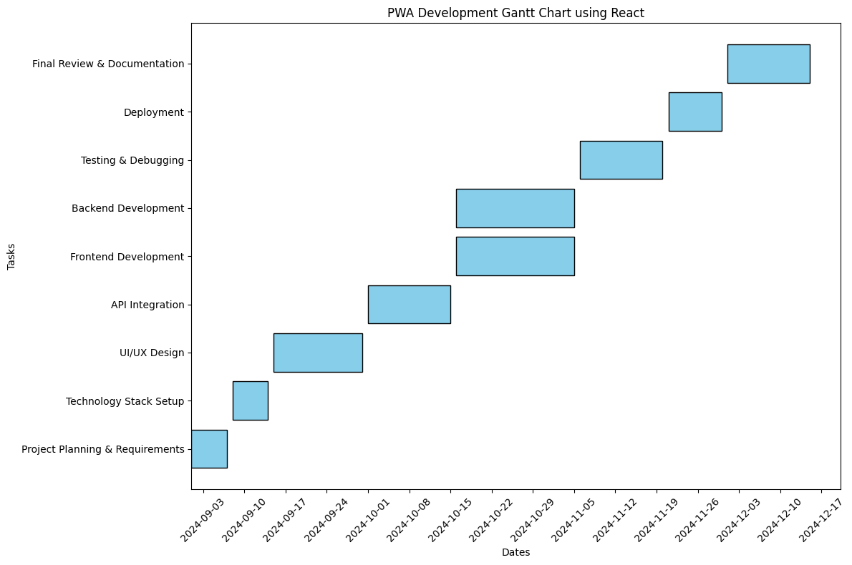
Timeline of the Project (Gantt Chart)

Slide 14
References (IEEE Paper format)
[1] Muawwal, A. (2024). The Implementation of PWA (Progressive Web App) Technology in Enhancing Website Performance & Mobile Accessibility. Buletin Pos dan Telekomunikasi, 22(1), 25-36.
[2] Rosayyan, P., Subramaniam, S., & Ganesan, S. I. (2020). Decentralized emergency service vehicle pre-emption system using RF communication and GNSS-based geo-fencing. IEEE Transactions on Intelligent Transportation Systems, 22(12), 7726-7735.
[3] Boduch, A., & Derks, R. (2020). React and React Native: A complete hands-on guide to modern web and mobile development with React. js. Packt Publishing Ltd.
[4] Pamungkas, S. L. T. A., Widiantoro, A. D., & Prasetya, F. X. (2021). Geographical Information System Complaints on Damage to Roads and Bridges in Semarang City. journal of busines and technology, 1(3), 104-109.
[5] Balla, D., & Gede, M. (2024). Beautiful thematic maps in Leaflet with automatic data classification. The International Archives of the Photogrammetry, Remote Sensing and Spatial Information Sciences, 48, 3-10.

Slide 15


